Slide 1

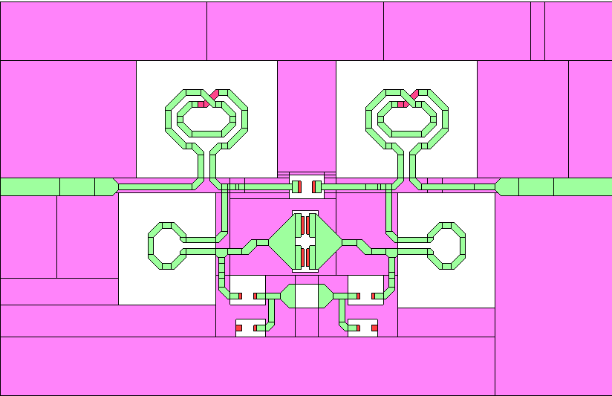


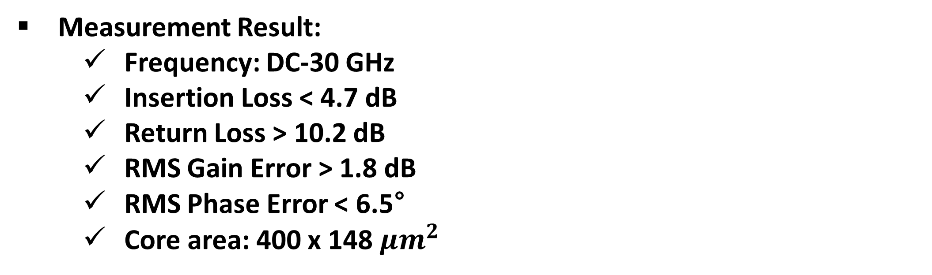
Design of a DC–30 GHz 5-Bit Digital Attenuator Using
Bridge Capacitors and Phase-Error Suppression Inductors
Byeong-Chan Lee, Jong-Seong Park, and Choul-Young Kim
Department of Electronics Engineering, Chungnam National University, Daejeon, Korea
I. INTRODUCTION
In millimeter-wave communication, phased array systems are one of the key approaches to overcome high attenuation.
The key aspect of a phased array system is adjusting the phase at each RF channel using phase shifters to steer strong electromagnetic wave radiation in a specific direction, but attenuators also play an important role.
Attenuators control the gain of each channel, serving functions such as preventing power saturation and suppressing side lobes.
This work presents a 5-bit digital attenuator operating from DC to 30 GHz, utilizing bridge capacitors and phase-error suppression inductors.
III. MEASUREMENT RESULT
Fig. 3. Layout of attenuator
Fig. 4. EM Structure of 8dB cell
II. CIRCUIT DESIGN
Fig. 1. Schematic of proposed attenuator
Fig. 5. Simulation and Measurement results of attenuator
Measurement Result:
    Frequency: DC-30 GHz
    Insertion Loss < 4.7 dB
    Return Loss > 10.2 dB
    RMS Gain Error > 1.8 dB
    RMS Phase Error < 6.5°
    Core area: 400 x 148 $μm^{2}$
IV. Comparison
Ref. | This work | [1] | [2] | [3]
Tech. | 28nm CMOS | 65nm CMOS | 0.18μm SOI CMOS | 65nm CMOS
BW (GHz) | DC-30 | 37-40 | DC-20 | 27.5-30.5
Return Loss(dB) | >10.2 | >12 | >12 | >10
Insertion Loss (dB) | <4.7 | <7 | <7.6 | N/A
RMS gain error (dB) | <1.76 | <0.27 | <0.5 | <0.5
RMS phase error (degree) | <6.5 | <3.7 | <2.5 | <5
Fig. 2. Each equivalent schematic of states of proposed 8dB cell
DC-30 GHz 5 bit Digital Attenuator(MSB : 8dB, LSB : 0.5dB)
Attenuating range : 0.5dB – 15.5dB
Applied Structure of each attenuator :
    Π-type attenuator(2dB, 4dB)
    Simplified T-type attenuator(0.5dB, 1dB, 2dB)
      The attenuator in this structure features a shorted RF input and output, resulting in very low insertion loss. It also offers a compact size due to its simple architecture and minimal component count.
    Π-type attenuator with bridge capacitor and phase error-suppressing inductor(8dB)
      The attenuator in this structure features a shorted RF input and output, resulting in very low insertion loss. It also offers a compact size due to its simple architecture and minimal component counts.
This attenuator features low insertion loss and a wider frequency range.
REFERENCES
[1] Zhao, C., Zeng, X., Zhang, L., Liu, H., Yu, Y., Wu, Y., & Kang, K. (2020). A 37–40-GHz low-phase-imbalance CMOS attenuator with tail-capacitor compensation technique. IEEE Transactions on Circuits and Systems I: Regular Papers, 67(10), 3400-3409.
[2] M.-K. Cho, J.-G. Kimol. 35, pp. 638—643, Apr. 2016.
[3] J. Han, J. Kim, J. Park, and J. Kim, “A ka-band 4-ch bi-directional CMOS T/R chipset for 5G beamforming system,” in Proc. IEEE Radio Freq. Integr. Circuits Symp. (RFIC), Honolulu, HI, USA, Jun. 2017, pp. 41–44.
Acknowledgement
The chip fabrication and EDA tool were supported by the IC Design Education Center(IDEC), Korea

